Slide 1
Exam AZ-700: Designing and Implementing Microsoft Azure Networking Solutions Training Course

Slide 2



Tim Warner
Based in Nashville, TN, US
Central time zone
MCT, MVP
Twitter: @TechTrainerTim
Badge: TechTrainerTim.com

Slide 3
Day 1 of 2 Agenda
Introduction
Hybrid Networking
Core Networking Infrastructure
Routing, Start

Slide 4
Day 2 of 2 Agenda
Routing, Finish
Secure and Monitor Networks
Private Access to Networks

Slide 5
Course Materials
timw.info/az700

Slide 6
Tim’s “Frankenstein Project”
timw.info/frankenstein

Slide 7
A Different Kind of Training
This is an expert certification, so we will move quickly and assume intermediate-level Azure skills
10-minute break at midpoint
I’m here to answer your questions – take advantage of this!
Use the Q&A panel

Slide 8
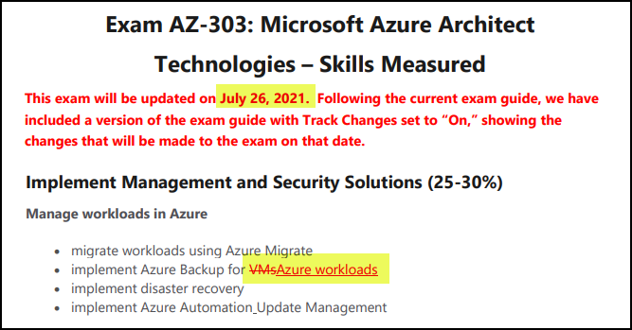
Azure Architect Latest Changes

Slide 9

Tim's Certification Study Model
Content knowledge
Test-taking skills
Practical application

Slide 10
Thank you!
Course materials: timw.info/az700
Twitter: @TechTrainerTim
Work: timw.info/ps
Web: TechTrainerTim.com

Slide 11


VM Networking

Slide 12

Site-to-Site VPN

Slide 13
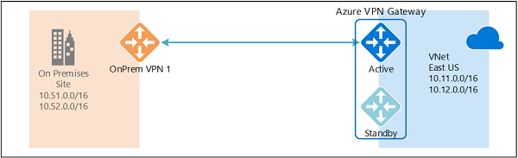
Active/Active VPN Topologies

Slide 14
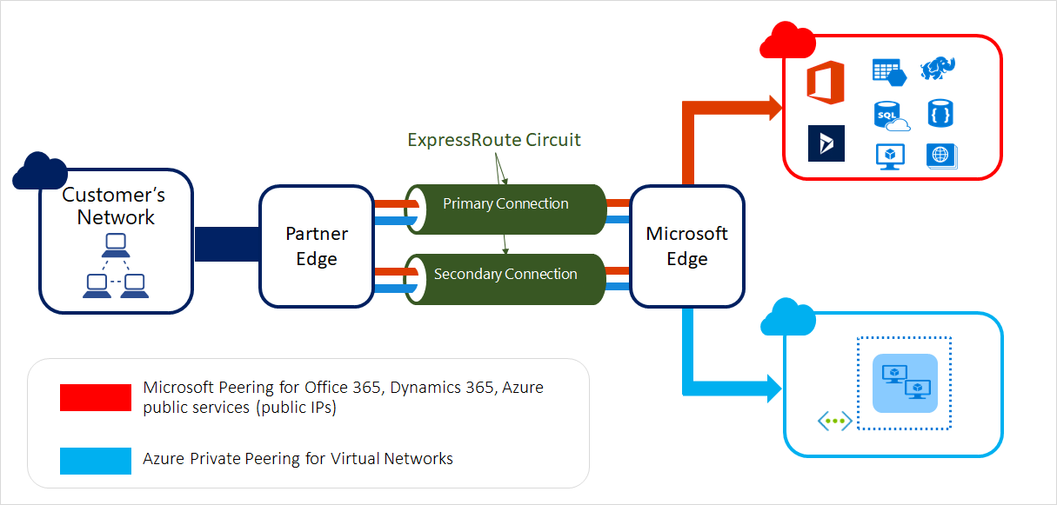
ExpressRoute Peering Types

Slide 15
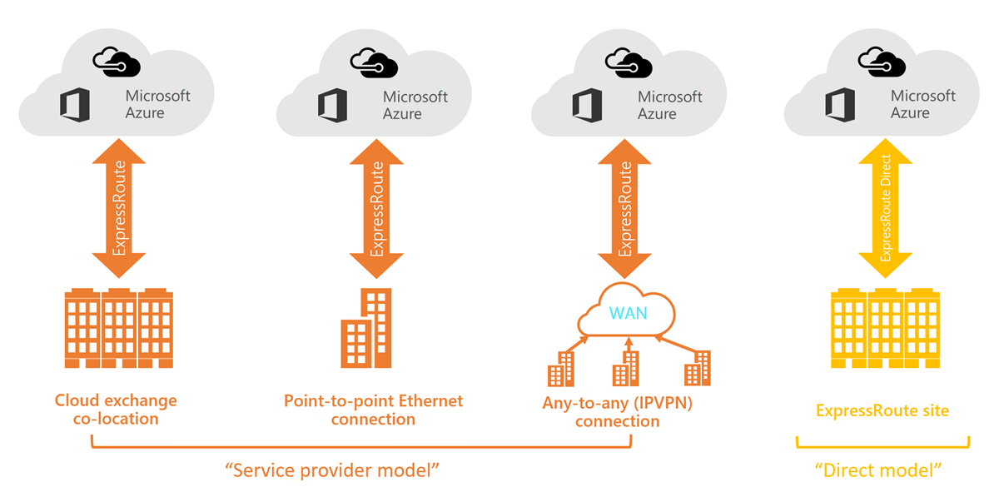
ExpressRoute Service Models

Slide 16
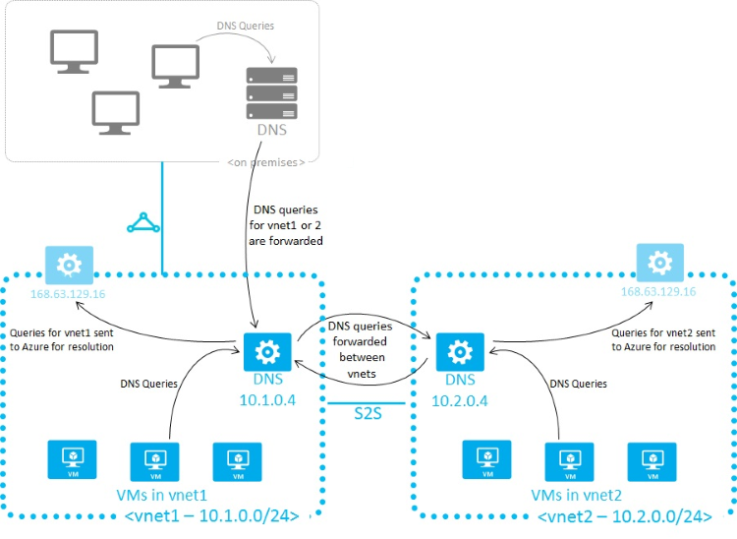
Azure Name Resolution

Slide 17
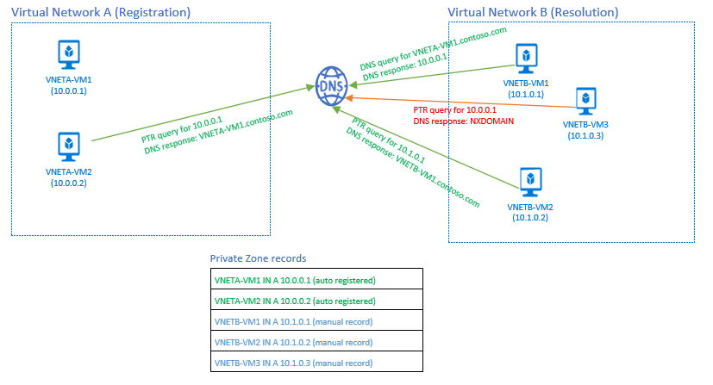
Azure DNS Private Zones

Slide 18
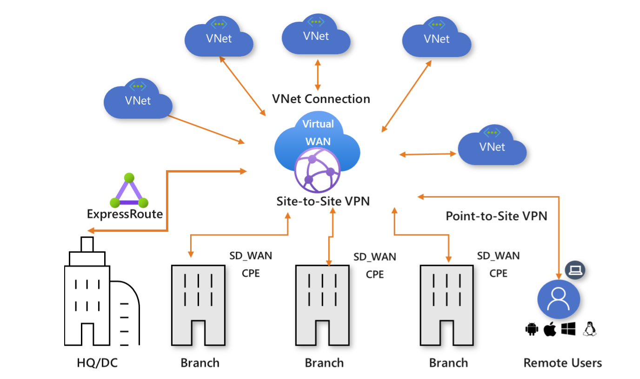
Virtual WAN

Slide 19
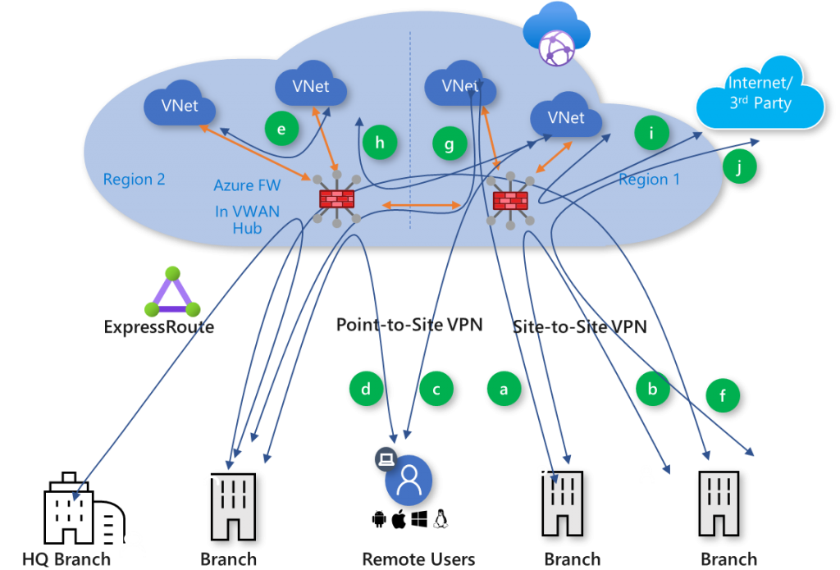
Secured Virtual Hub

Slide 20

Load Balancing

Slide 21

VNet Peering

Slide 22

Network Virtual Appliance

Slide 23

Azure Load Balancer

Slide 24

Application Gateway

Slide 25

Traffic Manager

Slide 26

Front Door Service

Slide 27
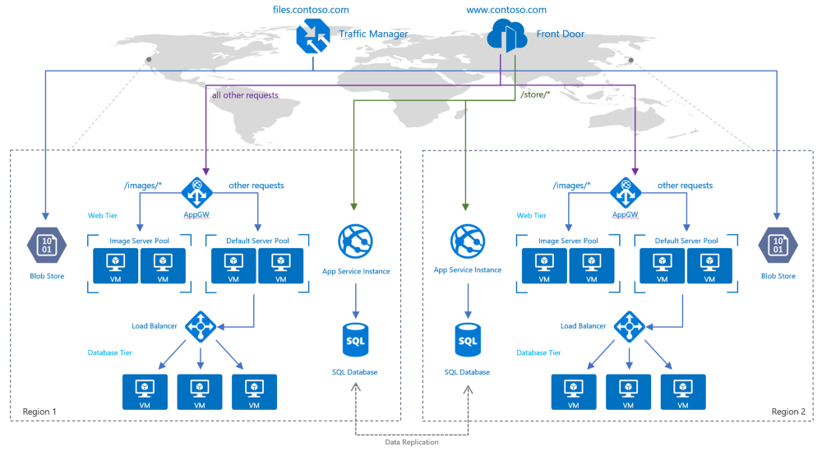
Traffic Manager vs Front Door

Slide 28
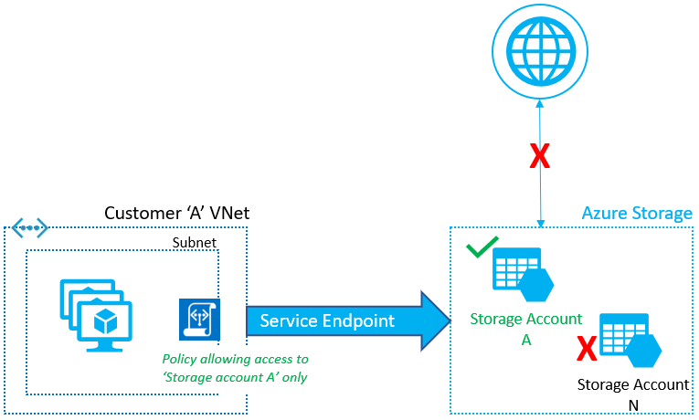
Service Endpoints

Slide 29
Private Endpoints

Slide 30
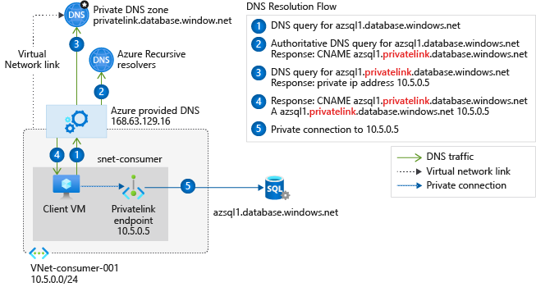
Private Endpoint DNS Config

Slide 31

Multiple Choice

Slide 32
Repeated Scenario
You need to move an Azure VM to another hardware host.
Solution: You redeploy the VM.
Does this solution meet the goal?
Yes
No

Slide 33

Select and Place

Slide 34

Build List and Reorder

Slide 35

Active Screen/Fill in the Blank

Slide 36

Case Study

Slide 37






Performance-Based Lab

Slide 38
Microsoft Online Testing Process
timw.info/online

Slide 39

Microsoft Online Testing Process

Slide 40

Microsoft Online Testing Process

Slide 41

Microsoft Online Testing Process

Slide 42

Microsoft Online Testing Process

Slide 43

Microsoft Online Testing Process

Slide 44

Microsoft Online Testing Process

Slide 45

Microsoft Online Testing Process

